Slide 1
GIDC DEGREE ENGINEERING COLLEGE
BRANCH-CIVIL
ENROLLMENT NO:
131100106001-ANKIT KANUBHAI THAKARIYA
131100106035-PATEL MILIND DHANSHUKHLAL
131100106004-CHAUDHARI PRANAV KUMAR
131100106025-PATEL DHAVALKUMAR
131100106007-DHODIYA NIRAL JAYESHBHAI
131100106031-PATEL KAUSHIKKUMAR BABUBHAI
131100106037-PATEL PRIYANKAKUMARI RAJESHBHAI
131100106027-PATEL DIVYABEN UMESHBHAI
131100106011-GODHANI RIDHAM BHARATBHAI
131100106001-DESAI VIVEK NARESHBHAI

Slide 2
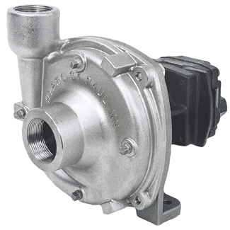
CENTRIFUGAL PUMP

Slide 3
Mechanical energy is converted into pressure energy by means of centrifugal force
Main parts of centrifugal pump
Impeller
Casing
Suction pipe
Foot valve
Strainer
Delivery pipe
Working
Suction head, delivery head & total head

Slide 4
Working Principle of Centrifugal pump
Principle: When a certain mass of fluid is rotated by an external source, it is thrown away from the central axis of rotation and a centrifugal head is impressed which enables it to rise to a higher level.

Slide 5
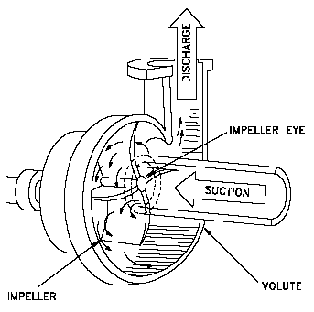
Centrifugal Pumps

Slide 6
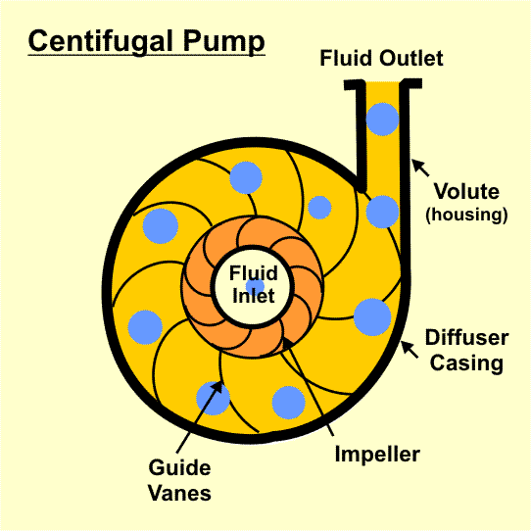
Centrifugal Pump - Working

Slide 7
Components of Centrifugal pump
A rotating component comprising of an impeller and a shaft.
A stationery component comprising a volute (casing), suction and delivery pipe.

Slide 8
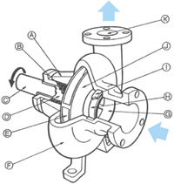
Volute and Vortex Casing
Volute Casing
Vortex Casing

Slide 9
Volute type pump
Impeller is surrounded by spiral casing (Volute chamber)
Volute chamber provides gradual increase in area of flow
Impeller increase the K.E. of liquid
Liquid leaving impeller enters in volute casing with high velocity & its pressure is increased due to increase in area
Disadvantage: greater eddy losses, so decreasing overall efficiency

Slide 11
Diffuser type pump (turbine pump)
Impeller is surrounded by series of guide blades mounted on a ring which is known as diffuser
Liquid leaving impeller flows through diffuser
Passage of diffuser is gradually increase
Velocity of liquid in diffuser decreases & pressure increases
Advantages:
More pressure head is developed
Pump efficiency is higher

Slide 12
Vortex type pump
Modification of volute pump
Circular chamber (annular space) is inserted between impeller & volute chamber
So chamber is combination of circular & spiral, known as whirlpool chamber
Liquid moving freely from impeller to volute chamber so velocity head is converted gradually in to pressure head

Slide 15
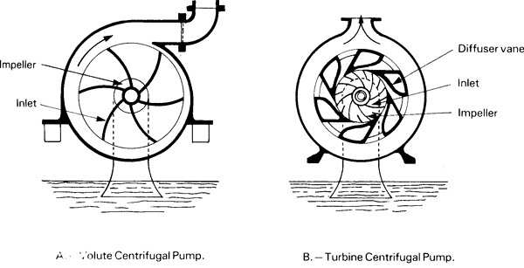
Volute and Diffuser casing
Volute Diffuser (guide Vane)

Slide 16
Volute and Diffuser casing
Volute Casing: In this type of casing the area of flow gradually increases from the impeller outlet to the delivery pipe.
Vortex Casing: If a circular chamber is provided between the impeller and volute chamber the casing is known as Vortex Chamber.
Diffuser Casinng :
The impeller is surrounded by a diffuser.
The guide vanes are designed in such a way that the water from the impeller enters the guide vanes without shock.
It reduces the vibration of the pump.
Diffuser casing, the diffuser and the outer casing are stationery parts.

Slide 17
Priming of a centrifugal Pump
The operation of filling the suction pipe, casing and a portion of delivery pipe with the liquid to be raised, before starting the pump is known as Priming
It is done to remove any air, gas or vapour from these parts of pump.

Slide 18
Single stage centrifugal pumps
Having only one impeller
Use: lower head & lower discharge
Multi stage centrifugal pumps
Having more then one impeller
Use: for higher head & higher discharge
Types:
Impeller in series
Impeller in parallel

Slide 19
Impeller in series
All impeller are mounted one shaft, arranged serially one after another enclosed in single casing
Use: for high head
If ‘n’ no. of impellers are mounted on shaft total head developed is ‘n’ time of head developed by single impeller

Slide 20
Impeller in parallel
Impellers are mounted on separate parallel shaft
Use: for high discharge
If ‘n’ no. of impellers are mounted on shaft total discharge of pump is ‘n’ time of discharge developed by single impeller

